Slide 1
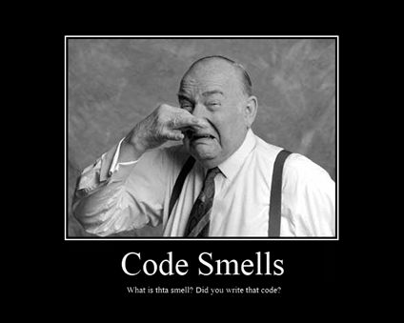

Slide 2
Agenda
day 1
clean comments
clean Functions
clean tests
clean class
day 2
oo programming
functional programming
reactive programming
ddd
secure code

Slide 3
Clean Code
Implementation Patterns
Refactoring
Refactoring to Patterns
Beautiful Code
Xunit Patterns
97 things very programmer should know
Solid Code
50 rules for High Scalability
Inside C++ object model
Modern C++ design
inside JVM

Slide 4
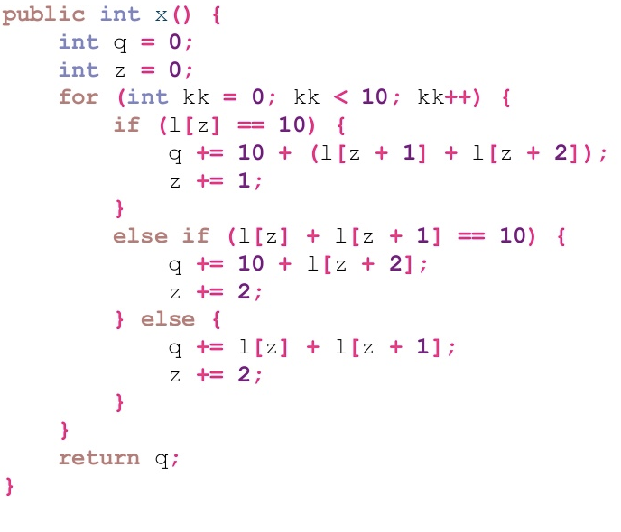

Slide 5
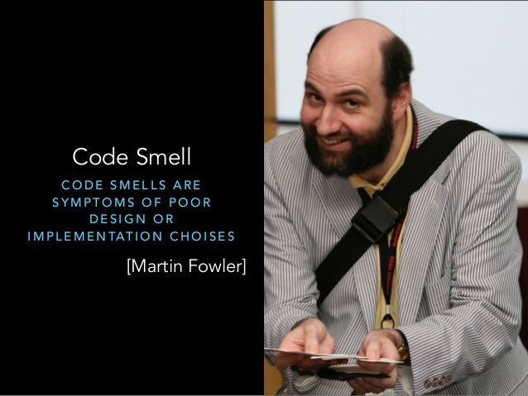

Slide 6
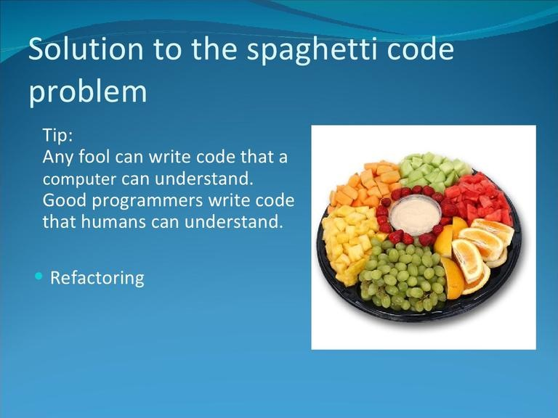

Slide 7


Slide 8

Notes:
If you find a mess on the ground, you clean it up regardless of who might have made the mess. You intentionally improve the environment for the next group of campers. ”Always leave the campground cleaner than you found it."

Slide 9
Problem Accumulation
Area was pristine clean for many days , one fine day a lazy guy threw garbage at the place just one bag , next one week place was filled with garbage , reason other people saw garbage and instead of picking it up they threw their own.

Slide 10
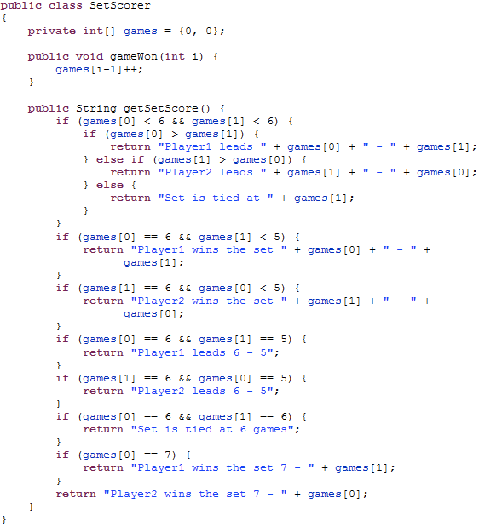

Slide 11
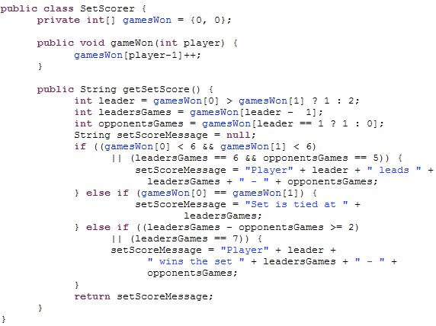

Slide 12
Comments

Slide 13

InputStreamResponse response = new InputStreamResponse();
response.setBody(formatter.getResultStream(), formatter.getByteCount());
// InputStream resultsStream = formatter.getResultStream();
// StreamReader reader = new StreamReader(resultsStream);
// response.setContent(reader.read(formatter.getByteCount()));
Notes:
Commented out code. I realize that this one is a lot of people favorite thing to do, but it is always wrong.
We are in an age when it is easy to setup a source code versioning system. If code is worth keeping, then check it in, it is saved now and forever. If you want to replace it with a new version delete it:
The old version will be around if you need it.
Commented out code makes code hard to read since it still looks like code, and takes up the same space as real code.
After a few changes to the original code, the commented out version is way out of date
I once saw a function that had over a hundred lines of commented out code, when I removed the commented out code, it was only 2 lines long.
Sometimes we comment out code during debugging and development. This is OK, just make sure to delete it before it is checked in.

Slide 14

Ruthlessly delete code that isn't being used.
Notes:
That's why we have source control systems!

Slide 15
/*
public void registerItem(Item item) {
if (item != null) {
ItemRegistry registry = peristentStore.getItemRegistry();
if (registry != null) {
Item existing = registry.getItem(item.getID());
if (existing.getBillingPeriod().hasRetailOwner()) {
existing.register(item);
}
}
}
}
….
*/
Notes:
delete it! Don’t worry, the source code control system still remembers it.
That code sits there and rots, getting less and less relevant with every passing day. It
calls functions that no longer exist. It uses variables whose names have changed. It follows
conventions that are long obsolete. It pollutes the modules that contain it and distracts the
people who try to read it. Commented-out code is an abomination.
When you see commented-out code, delete it! Don’t worry, the source code control
system still remembers it. If anyone really needs it, he or she can go back and check out a
previous version. Don’t suffer commented-out code to survive.

Slide 16

It is inappropriate for a comment to hold information better held in a as source code control system, issue tracking system, or any other record-keeping system.
Notes:
It is inappropriate for a comment to hold information better held in a different kind of system
such as your source code control system, your issue tracking system, or any other
record-keeping system. Change histories, for example, just clutter up source files with
volumes of historical and uninteresting text
In general, meta-data such as authors, lastmodified- date, SPR number, and so on should not appear in comments. .

Slide 17
/**
* @dateModified 12/12/1947
* @modifiedBy RamgopalVerma
* @modifiedReason because sky is so high
* /
public class Patient
{
}

Slide 18

Avoid Obsolete Comment
It is best not to write a comment that will become obsolete.
They become floating islands of irrelevance and misdirection in the code.
Notes:
A comment that has gotten old, irrelevant, and incorrect is obsolete. Comments get old
quickly. It is best not to write a comment that will become obsolete. If you find an obsolete
comment, it is best to update it or get rid of it as quickly as possible. Obsolete comments
tend to migrate away from the code they once described. They become floating islands of
irrelevance and misdirection in the code.

Slide 19

Dead Function
Methods that are never called should be discarded.
Notes:
Keeping dead code around is wasteful.
Don’t be afraid to delete the function. Remember, your source code control system still remembers it.

Slide 20
patientCount++; // add patient hospital visiting

Slide 21

A comment worth writing is worth writing well.
Notes:
A comment worth writing is worth writing well. If you are going to write a comment,
take the time to make sure it is the best comment you can write. Choose your words
carefully. Use correct grammar and punctuation. Don’t ramble. Don’t state the obvious.
Be brief.

Slide 22
i++; // increment I

Slide 23
Comments are Failures
they compensate for our inability to express in code

Slide 24
/**
* Returns the day of the month.
*
* @return the day of the month.
*/
public int getDayOfMonth() {
return dayOfMonth;
}

Slide 25

Comments should say things that the code cannot say for itself.

Slide 26
//Add Books associated with the Category
public void add(Category category)
{ bookMap.put(category.getCategoryId(),
category.getBooks()); }

Slide 27
Explain Yourself in Code
public void addBooksFromCategory(Category category)
{ bookMap.put(category.getCategoryId(), category.getBooks()); }

Slide 28
// Check to see if the employee is eligible for full benefits
if ((employee.flags && HOURLY_FLAG) && (employee.age > 65))

Slide 29
Explain Yourself in Code
if (employee.isEligibleForFullBenefits())

Slide 30
double getExpenseLimit() {
// should have either expense limit or a primary project
return (_expenseLimit != NULL_EXPENSE) ?
_expenseLimit:
_primaryProject.getMemberExpenseLimit();
}

Slide 31
Introduce Assertion
double getExpenseLimit() {
Assert.isTrue (_expenseLimit != NULL_EXPENSE || _primaryProject != null);
return (_expenseLimit != NULL_EXPENSE) ?
_expenseLimit:
_primaryProject.getMemberExpenseLimit();
}
Notes:
A section of code assumes something about the state of the program.
Make the assumption explicit with an assertion.

Slide 32
Error

Slide 33
public class DeviceController {
...
public void sendShutDown() {
DeviceHandle handle = getHandle(DEV1);
// Check the state of the device
if (handle != DeviceHandle.INVALID) {
// Save the device status to the record field
retrieveDeviceRecord(handle);
// If not suspended, shut down
if (record.getStatus() != DEVICE_SUSPENDED) {
pauseDevice(handle);
clearDeviceWorkQueue(handle);
closeDevice(handle);
} else {
logger.log("Device suspended. Unable to shut down");
}
} else {
logger.log("Invalid handle for: " + DEV1.toString());
}
}
...
}

Slide 34
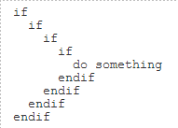

Arrow Code
Notes:
http://www.codinghorror.com/blog/2006/01/flattening-arrow-code.html
\Where appropriate, I flatten that arrow code by doing the following:
Replace conditions with guard clauses. This code..
if (SomeNecessaryCondition) { // function body code } .. works better as a guard clause:
if (!SomeNecessaryCondition) { throw new RequiredConditionMissingException; } // function body code
Decompose conditional blocks into seperate functions. In the above example, we're in a do..while loop which could be decomposed:
do { ValidateRowAttribute(drc[rowIdx]); rowIdx++; } while(rowIdx < rowCount && GetIdAsInt32(drc[rowIdx]) == Id);
Convert negative checks into positive checks. As a broad rule, I prefer to put the positive comparison first and let the negative comparison fall out naturally into the else clause. I think this reads a lot better and, more importantly, avoids the "I ain't not doing that" syndrome:
if (Attributes[attrVal.AttributeClassId] is ArrayList) { // do stuff } else { // do stuff }
Always opportunistically return as soon as possible from the function. Once your work is done, get the heck out of there! This isn't always possible -- you might have resources you need to clean up. But whatever you do, you have to abandon the ill-conceived idea that there should only be one exit point at the bottom of the function.

Slide 35
Use Exceptions Rather Than Return Codes
public class DeviceController {
...
public void sendShutDown() {
try {
tryToShutDown();
} catch (DeviceShutDownError e) {
logger.log(e);
}
}
private void tryToShutDown() throws DeviceShutDownError {
DeviceHandle handle = getHandle(DEV1);
DeviceRecord record = retrieveDeviceRecord(handle);
pauseDevice(handle);
clearDeviceWorkQueue(handle);
closeDevice(handle);
}
private DeviceHandle getHandle(DeviceID id) {
...
throw new DeviceShutDownError("Invalid handle for: " + id.toString());
...
}
...
}

Slide 36
void DoJob()
{
Domain domain = new Domain();
bool res = domain.fun();
if(res == true){
res = domain.fun2(100);
if(res == true){
Repostory rep = new Repository();
Emp emp = rep.get(1);
if(emp != null){
...
}else{
…
}
}else{
…
}
}else{
…
}
}

Slide 37
void DoJob()
{
Domain domain = new Domain();
domain.fun();
domain.fun2(100);
Repostory rep = new Repository();
Emp emp = rep.get(1);
...
}
try{
DoJob();
}catch(…){
….
}

Slide 38
int withdraw(int amount) {
if (amount > _balance)
return -1;
else {
_balance -= amount;
return 0;
}
}

Slide 39
Replace Error Code with Exception
void withdraw(int amount) throws BalanceException {
if (amount > _balance)
throw new BalanceException();
_balance -= amount;
}
Notes:
A method returns a special code to indicate an error.

Slide 40
double getValueForPeriod (int periodNumber) {
try {
return _values[periodNumber];
} catch (ArrayIndexOutOfBoundsException e) {
return 0;
}
}

Slide 41
Replace Exception with Test
double getValueForPeriod (int periodNumber) {
if (periodNumber >= _values.length)
return 0;
return _values[periodNumber];
}
Notes:
You are throwing an exception on a condition the caller could have checked first.

Slide 42
private static List readLines(String fileName)
{
String line;
ArrayList list= new ArrayList();
try
{
BufferedReader in = new BufferedReader(new FileReader(fileName));
while ((line = in.readLine()) != null)
list.add(line);
in.close();
}
catch (Exception e)
{
System.out.println(e);
return null;
}
return list;
}

Slide 43
Always know why you are catching an exception
private static ArrayList readLines(String fileName) throws IOException
{
String line;
ArrayList file = new ArrayList();
using(BufferedReader in = new BufferedReader(new FileReader(fileName)))
{
while ((line = in.readLine()) != null)
file.add(line);
}
return file;
}
Notes:
The catch block here does nothing useful. In fact, it hides useful information if the program were to crash. If you don't catch the exception, you get a traceback. If you do catch it you get much less. Plus, it takes up 5 lines, and it makes the method almost twice as big as it needs to be. Doing without is just a lot better.

Slide 44
public void create(Map<String,Object> results) throws Exception {
//validate condition
if(condition) {
results.set("ERROR_CODE","CONDITION VIOLATED");
}
}
Map<String,Object> results = new HashMap<>();
create(results);
if(results.containsKey("ERROR_CODE")) {
...
}

Slide 45
Mixing error handling with output
Use Exceptions
public void create(Map<String,Object> results) throws Exception {
//validate condition
if(condition) {
throw new ConditionViolatedException();
}
}
try {
Map<String,Object> results = new HashMap<>();
create(results);
}
catch(ConditionViolatedException exp) {
}

Slide 46
String line;
ArrayList file = new ArrayList();
try
{
BufferedReader in = new BufferedReader(new FileReader(fileName));
while ((line = in.readLine()) != null)
{
file.add(line);
}
in.close();
}
catch (Exception e)
{
}

Slide 47
//method 1
catch(SQLException exp) {
log.fatal("Exception occurred:", exp);
throw exp;
}
//method 2
try {
//call method 1
}
catch(Exception exp) {
log.fatal("Exception occurred:", exp);
}
Notes:
Logging exception stack trace multiple times

Slide 48
Log exception stack trace only once
//method 1
catch(SQLException exp) {
log.fatal("Exception occurred:", exp);
throw exp;
}
//method 2
try {
//call method 1
}
catch(Exception exp) {
}

Slide 49
catch(InterruptedException e) {
AppException exp = new AppException();
exp.addError(Constants.ERROR_CODE, "EXP005");
exp.addError(Constants.ERROR_MESG, e.getMessage());
throw exp;
}
catch(SQLException e) {
AppException exp = new AppException();
exp.addError(Constants.ERROR_CODE, "EXP011");
exp.addError(Constants.ERROR_MESG, e.getMessage());
throw exp;
}
catch(Exception e) {
AppException exp = new AppException();
exp.addError(Constants.ERROR_CODE, "EXP003");
exp.addError(Constants.ERROR_MESG, e.getMessage());
throw exp;
}

Slide 50
remove duplicate code
private AppException createAppException(String errorCode) {
AppException exp = new AppException();
exp.addError(Constants.ERROR_CODE, errorCode);
exp.addError(Constants.ERROR_MESG, exp.getMessage());
return exp;
}
//code
catch(InterruptedException exp) {
throw createAppException("EXP005");
}
catch(SQLException exp) {
throw createAppException("EXP011");
}
catch(Exception exp) {
throw createAppException("EXP003");
}

Slide 51
void fun()
{
try
{
…logic 1
if(cond)
throw new Exception(…);
…logic 2
}
catch(Exception e)
{
…logic 3
}
}
Notes:
This bad example comes from Apache CXF Web Service Development book by Naveen Balani and Rajeev Hathi.

Slide 52
try {
…
} catch (Exception e) {
LOGGER.error("Exception :", e);
LOGGER.debug("Exception :" + e.getMessage());
try {
con.rollback();
} catch (SQLException e1) {
LOGGER.error("Exception :", e1);
LOGGER.debug("Exception :" + e1.getMessage());
}
} finally {
try {
con.close();
} catch (SQLException e1) {
LOGGER.error("Exception :", e1);
LOGGER.debug("Exception :" + e1.getMessage());
}
}

Slide 53
functions

Slide 54
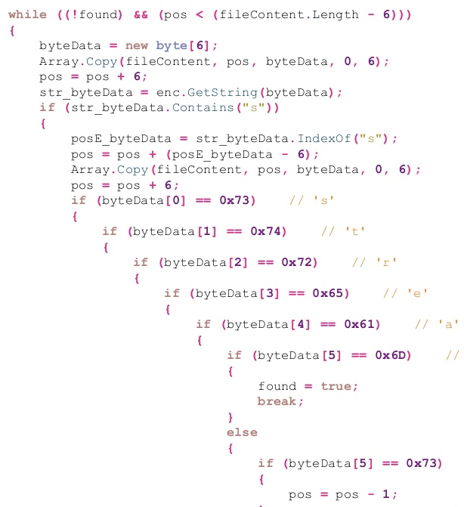

Slide 55

Nesting Levels
{if < 4 , switch,while,do, for <3}
Notes:
With certain algorithms, the measure indicates multi-dimensional array processing. The industry standards are typically 4, 2 & 2 for the constructs listed.

Slide 56
double potentialEnergy(double mass, double height) {
return mass * height * 9.81;
}
Notes:
Use of String literals in multiple classes

Slide 57

Magic Numbers and Strings
Explicit is better than implicit. - Tim Peters, The Zen of Python

Slide 58
Replace Magic Number with Symbolic Constant
double potentialEnergy(double mass, double height) {
return mass * GRAVITATIONAL_CONSTANT * height;
}
static final double GRAVITATIONAL_CONSTANT = 9.81;

Slide 59
Create a class for constants
public class Constants {
public static final String Y = "Y";
}
if(validate.equals(Constants.Y)) {
}

Slide 60

Classes
DO NOT create a dreadful 4000-lines Constants class !
Notes:
Define a constant in the class that uses it the most
Even in a domain entity class
The same for enums
Next to that class or even nested inside

Slide 61
Define constants in properties file
Constants.properties
VALIDATION_FLAG=Y
public class Constants {
private ResourceBundle bundle = ResourceBundle.getBundle("Constants");
public static final String VALIDATION_FLAG = bundle.getProperty("VALIDATION_FLAG");
}
//usage in code
if(validate.equals(Constants.VALIDATION_FLAG)) {
}

Slide 62
class Program
{
static void Main(string[] args){
DoSomething();
DoSomethingAgain();
DoSomethingMore();
DoSomethingExtraordinary();
Console.ReadLine();
}
private static void DoSomething(){
string address = "Stockholm, Sweden";
string format = "{0} is {1}, lives in {2}, age {3}";
Console.WriteLine(format, "Nils", "a good friend", address, 30);
}
private static void DoSomethingAgain(){
string address = "Stockholm, Sweden";
string format = "{0} is {1}, lives in {2}, age {3}";
Console.WriteLine(format, "Christian", "a neighbour", address, 54);
}
private static void DoSomethingMore() {
string address = "Stockholm, Sweden";
string format = "{0} is {1}, lives in {2}, age {3}";
Console.WriteLine(format, "Eva", "my daughter", address, 4);
}
private static void DoSomethingExtraordinary(){
string address = "Stockholm, Sweden";
string format = "{0} is {1}, lives in {2}, age {3}";
Console.WriteLine(format, "Lilly", "my daughter's best friend", address, 4);
}
}
Notes:
This bad example comes from Apache CXF Web Service Development book by Naveen Balani and Rajeev Hathi.

Slide 63
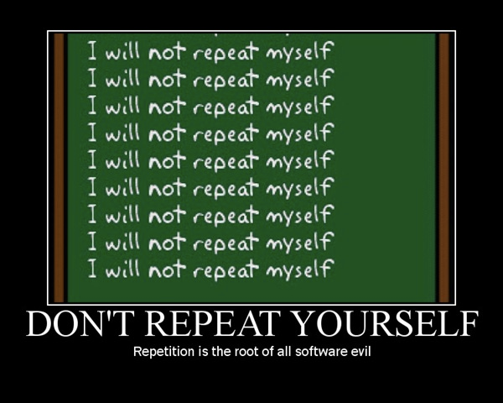

Slide 64

Disable the paste function on every developer machine
Notes:
One simple approach that's suggested quite often as a way to improve people's code is to disable the paste function on every developer machine. While the idea may be a little over the top, the basic thought is sound. If you have a snippet of, say, 7 lines of code that do one thing, and you want to do it again to a different set of variables, don't copy and paste the code. Instead, make a function (or a method, if you're stuck with Java).
There are several reasons for this. One is simple brevity. Another is that it makes your code much easier to read, since you would effectively be replacing 14 lines of code with just 2. This would obviously be at the expense of an additional function/method, but since these stand alone and isolated from the rest of the code, their impact on readability is very low. The main reason, however, is that by doing this you make life much easier for yourself. Even if this is a one-time script, you are still going to change the code around. This is easier if it's broken up into parts, like functions/methods.

Slide 65
class Program
{
private static string address = Constants.Address;
private static string format = Constants.StandardFormat;
static void Main(string[] args)
{
DoSomething();
DoSomethingAgain();
DoSomethingMore();
DoSomethingExtraordinary();
Console.ReadLine();
}
private static void DoSomething()
{
Console.WriteLine(format, "Nils", "a good friend", address, 30);
}
private static void DoSomethingAgain()
{
Console.WriteLine(format, "Christian", "a neighbour", address, 54);
}
private static void DoSomethingMore()
{
Console.WriteLine(format, "Eva", "my daughter", address, 4);
}
private static void DoSomethingExtraordinary()
{
Console.WriteLine(format, "Lilly", "my daughter's best friend", address, 4);
}
}

Slide 66
public class Employee
{
public string Name { get; set; }
public int Age { get; set; }
public string Department { get; set; }
}
private static IEnumerable<Employee> GetEmployees()
{
return new List<Employee>()
{
new Employee(){Age = 30, Department="IT", Name="John"}
, new Employee(){Age = 34, Department="Marketing", Name="Jane"}
, new Employee(){Age = 28, Department="Security", Name="Karen"}
, new Employee(){Age = 40, Department="Management", Name="Dave"}
};
}

Slide 67
“Perfection (in enterprise development) is achieved not when there is nothing more to add, but rather when there is nothing more to take away.”
--Antoine de Saint-Exupéry

Slide 68
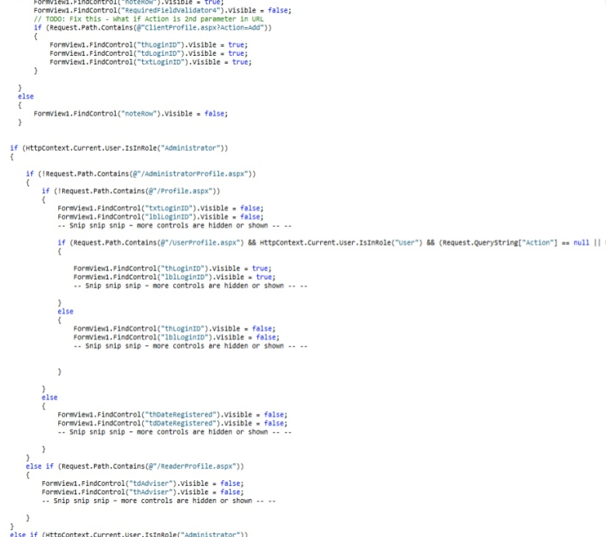

Slide 69

Long Method
Notes:
A shorter method is easier to read, easier to understand, and easier to troubleshoot

Slide 70
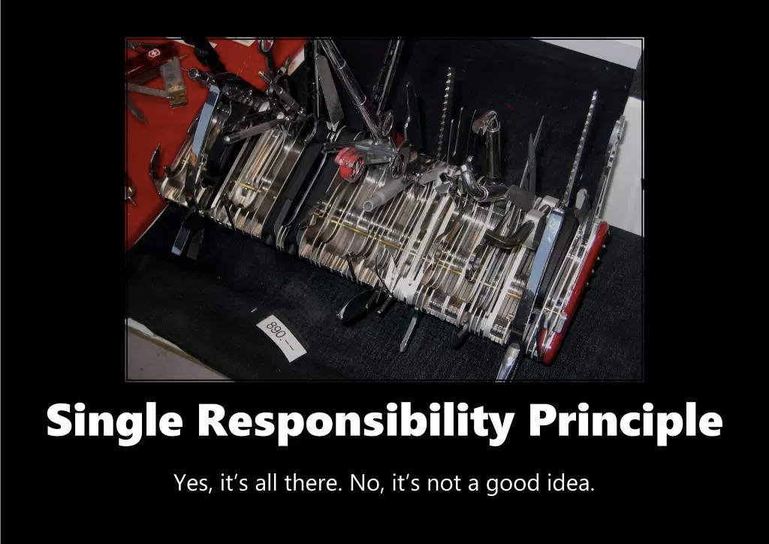

Slide 71
Functions Should be Small !!
Functions
How small ?
4 lines is best; 5 is ok; 6 is already too much
By any means, keep your functions smaller than a page of your IDE !
Why so small ?!
To be sure that they do only 1 THING
In a few lines, you can’t do much
Its name can then tell you everything
Notes:
nu ne pierdem in detalii: ramanem focusati pe design

Slide 72
Public void doTheDomesticThings()
{
takeOutTheTrash();
walkTheDog();
for(Dish dish : dirtyDishStack)
{
sink.washDish(dish);
teaTowel.dryDish(dish);
}
}

Slide 73
Don’t mix levels of abstraction
Public void doTheDomesticThings()
{
takeOutTheTrash();
walkTheDog();
doTheDishes();
}

Slide 74
double getPrice()
{
int basePrice = _quantity * _itemPrice;
double discountFactor;
if(basePrice > 1000)
discountFactor = 0.95;
else
discountFactor = 0.98;
return basePrice * discountFactor;
}

Slide 75
Replace Temp with Query
double getPrice()
{
return basePrice() * discountFactor();
}
private double discountFactor()
{
if(basePrice > 1000)
return 0.95;
else
return 0.98;
}
private int basePrice()
{
return _quantity * _itemPrice;
}
Notes:
The main cause of the long methods is usually the temporary variable declaration
which assigns value only once. These temporary variables are usually not of much use as
their scope is only inside the method. Thus the right hand side of these variables can be
extracted into individual methods and the variable can be declared as final making it easier to
apply “Extract Method.”
In the above example the basePrice and the discountedFactor both are the temporary
variables in getPrice method. These variable declarations and assignments are replaced by
creating individual methods which are used as and when required in the method.

Slide 76
File CreateFile(string name, boolean isTemp)
{
//implementation
}
myfile = CreateFile("foo.txt", true);
Notes:
This bad example comes from Apache CXF Web Service Development book by Naveen Balani and Rajeev Hathi.

Slide 77
Function Signature
Functions
Max 2 parameters
For ≥ 3 parameters, it's hard to read: their order becomes a problem
group them in a Parameter Object/DTO
Avoid output parameters
The caller may be surprised that an argument changed
No flag parameters (boolean, enum) ^{= laziness/fear}
It shouts that the function does more than one thing !
Split it into smaller functions
myBadMethod("John","Michael", "Paris","St. Albergue");
params.setStreet("Paris");… myBadMethod(params);
checkCustomer(customer, order);
?!
customer.setLoggedIn(true);
removeOrders(customer, false, true);
Notes:
Same Goal: the code should speak for itself
The reader shouldn't have to look at the function definition nor to its usages

Slide 78
Reveal Intend
File CreatePermenantFile(String name);
File CreateTempFile(String name);

Slide 79
Reveal Intend
myFile = CreateFile("foo.txt", FileType.Temp);

Slide 80
Reveal Intend
isTemp = true;
CreateFile("foo.bar", isTemp);
If you have to call an existing API that uses this style, you should introduce a local variable for clarity.

Slide 81
render(true)
void render(boolean isSuite)
{
…
}

Slide 82
Flag Arguments are Ugly
void renderForSuite()
{
….
}
void renderForSingleTest()
{
…..
}
Notes:
loudly proclaiming that this function does more than one thing. It does one thing if the flag is true and another if the flag is false!
Boolean arguments loudly declare that the function does more than one thing. They are
confusing and should be eliminated.

Slide 83
Use descriptive variable names
private static List readLines(String fileName) throws IOException
{
String line;
List lines = new ArrayList();
BufferedReader in = new BufferedReader(new FileReader(fileName));
while ((line = in.readLine()) != null)
lines.add(line);
in.close();
return lines;
}

Slide 84
void bad_handle_data(char *data, size_t length)
{
if (check_CRC(data, length) == OK)
{
/* * 30 * lines * of * data * handling */
}
else
{
printf("Error: CRC check failed\n");
}
}
Notes:
This bad example comes from Apache CXF Web Service Development book by Naveen Balani and Rajeev Hathi.

Slide 85
Test Exception instead of normal code
void good_handle_data(char *data, size_t length)
{
if (check_CRC(data, length) != OK)
{
printf("Error: CRC check failed\n");
return;
}
/* * 30 * lines * of * data * handling */
}

Slide 86
public void registerItem(Item item) {
if (item != null) {
ItemRegistry registry = peristentStore.getItemRegistry();
if (registry != null) {
Item existing = registry.getItem(item.getID());
if (existing.getBillingPeriod().hasRetailOwner()) {
existing.register(item);
}
}
}
}
Notes:
If you are tempted to return null from a method, consider throwing an exception or returning a SPECIAL CASE object instead.

Slide 87
Customer c = findCustomer(...);
...
if (customer == null) {
name = “occupant”
} else {
name = customer.getName()
}
if (customer == null) {
…
}

Slide 88
public void registerItem(Item item) {
if (item != null) {
ItemRegistry registry = peristentStore.getItemRegistry();
if (registry != null && registry.Count > 0) {
Item existing = registry.getItem(item.getID());
if (existing !=null && existing.getBillingPeriod().hasRetailOwner()) {
existing.register(item);
}
if (existing !=null && !existing.getBillingPeriod().hasRetailOwner()) {
existing.unregister(item);
}
if (existing !=null) {
existing.remove(item);
}
}
}
}

Slide 89
List<Employee> employees = getEmployees();
if (employees != null) {
for(Employee e : employees) {
totalPay += e.getPay();
}
}
….

Slide 90
Don’t Return Null
If we change getEmployee so that it returns an empty list
List<Employee> employees = getEmployees();
for(Employee e : employees) {
totalPay += e.getPay();
}
Fortunately, Java has Collections.emptyList(), and it returns a predefined immutable
public List<Employee> getEmployees() {
if( .. there are no employees .. )
return Collections.emptyList();
}

Slide 91

Function Signature (2)
Functions
No nullable parameters
It's like a boolean  split that function in 2: one for null, one for not-null
Thoroughly check parameters at boundaries (=defensive programming)
Don’t return null
Null is the worst mistake in IT ^{[dzone]}
Consider Optional<> / throw exception / Null Object Pattern
Unchecked Exceptions won !
No more try/throws/empty catch(); no return status codes
Runtime Exceptions don’t annoy the caller
Can be handled uniformly in a transparent layer at the entry points
Can hold enum error codes for (i18n) user messages
Define custom exception sub-types for recoverable errors (selective catch)
Notes:
Mai mult de 3 parametrii – de unde stii ordinea ?

Slide 92
public WebUser getCurrentUser(){
if (_currentUser == null) {
Object obj = HttpContext.Current.Session["__currentUser"];
if (obj != null) {
_currentUser = (WebUser)obj;
return _currentUser;
}
SecurityHelper secHelper = new SecurityHelper();
WebUserRepository rep = new WebUserRepository();
if (secHelper.TrackingGuid != Guid.Empty){
_currentUser = rep.GetWebUserByTrackingGuid(secHelper.TrackingGuid);
if (_currentUser != null)
return _currentUser;
}
WebUserFactory factory = new WebUserFactory();
_currentUser = factory.CreateWebUser();
}
return _currentUser;
}

Slide 93
Avoid multiple returns
private WebUser _currentUser;
public WebUser getCurrentUser()
{
if (_currentUser == null) _currentUser = GetWebUserFromSession();
if (_currentUser == null) _currentUser = GetWebUserFromTrackingCookie();
if (_currentUser == null) _currentUser = CreateNewWebUser();
return _currentUser;
}
private WebUser GetWebUserFromSession()
{
Object obj = HttpContext.Current.Session["__currentUser"];
return obj == null ? null : (WebUser)obj;
}
private WebUser GetWebUserFromTrackingCookie()
{
SecurityHelper secHelper = new SecurityHelper();
WebUserRepository rep = new WebUserRepository();
if (secHelper.TrackingGuid == Guid.Empty)
return null;
else
return rep.GetWebUserByTrackingGuid(secHelper.TrackingGuid);
}
private WebUser CreateNewWebUser()
{
WebUserFactory factory = new WebUserFactory();
return factory.CreateWebUser();
}
Notes:
multiple returns nested in conditional blocks

Slide 94
double getPayAmount() {
double result;
if (_isDead) result = deadAmount();
else {
//logic
if (_isSeparated) result = separatedAmount();
else {
//logic
if (_isRetired) result = retiredAmount();
else result = normalPayAmount();
};
}
return result;
};

Slide 95
Replace Nested Conditional with Guard Clauses
double getPayAmount() {
if (_isDead) return deadAmount();
if (_isSeparated) return separatedAmount();
if (_isRetired) return retiredAmount();
return normalPayAmount();
};
Notes:
A method has conditional behavior that does not make clear what the normal path of execution is

Slide 96
public List<Integer> stringsToInts( List<String> strings) {
if (strings != null) {
List<Integer> integers = new ArrayList<>();
for (String s : strings) {
integers.add(Integer.parseInt(s));
}
return integers;
} else {
return null;
}
}

Slide 97
use Early returns
public List<Integer> stringsToInts2( List<String> strings) {
if (strings == null) {
return null;
}
List<Integer> integers = new ArrayList<>();
for (String s : strings) {
integers.add(Integer.parseInt(s));
}
return integers;
}
Reduces the number of indentations
Notes:
A method has conditional behavior that does not make clear what the normal path of execution is

Slide 98
if (rowCount > rowIdx) {
if(drc[rowIdx].Table.Columns.Contains("avalId")) {
do {
if (Attributes[attrVal.AttributeClassId] == null) {
// do stuff
}
else {
if (!(Attributes[attrVal.AttributeClassId] is ArrayList)) {
// do stuff
}
else {
if (!isChecking) {
// do stuff
} else
{
// do stuff
} }
}
rowIdx++;
} while(rowIdx < rowCount && GetIdAsInt32(drc[rowIdx]) == Id);
}
else rowIdx++;
}
return rowIdx;

Slide 99
Cyclometic Complexity
public void ProcessPages()
{
while(nextPage !=true)
{
if((lineCount<=linesPerPage) && (status != Status.Cancelled) && (morePages == true))
{
//....
}
}
}
Notes:
In the code above, we start with 1 for the routine, add 1 for the while loop, add 1 for the if, and add 1 for each && for a total calculated complexity of 5.

Slide 100
Cyclometic Complexity
public int getValue(int param1)
{
int value = 0;
if (param1 == 0)
{
value = 4;
}
else
{
value = 0;
}
return value;
}
Notes:
In the code above, we start with 1 for the routine, add 1 for the if, and add 1 for the else for a total calculated complexity of 3.

Slide 101
Cyclometic Complexity
CC Value | Risk
1-10 | Low risk program
11-20 | Moderate risk
21-50 | High risk
>50 | Most complex and highly unstable method

Slide 102
private int x;
public int increment_and_return_x()
{
x = x + 1;
return x;
}
Notes:
This bad example comes from Apache CXF Web Service Development book by Naveen Balani and Rajeev Hathi.

Slide 103

Command / Query Separation
A Query doesn't have side effects
and returns a result
getState():State, isLoggedIn():boolean, findCustomer():Customer
A Command changes the system state
and returns void
processOrder(Order), consumeMessage(Message), setName(String)
Avoid doing both in the same method
processOrder(Order):boolean (that returns false if it failed)
(It forces the caller to check the result right away. Prefer exceptions instead!)
?
!

Slide 104
private int x;
public int value()
{
return x;
}
void increment()
{
x = x + 1;
}
Notes:
This bad example comes from Apache CXF Web Service Development book by Naveen Balani and Rajeev Hathi.

Slide 105
string result = _storeService.PurchaseItem(buyer, item);
Notes:
is this code breaking CQS,
CQS is a good programming principle on code level in any part of your application. Not just the domain area. The principle exists way longer than DDD (and CQRS). It says not to mess up commands that change any state of the application with queries that just return data and can be invoked any time without changing any state.

Slide 106
Data Structure

Slide 107
Map sensors = new HashMap();
…
Sensor s = (Sensor)sensors.get(sensorId );

Slide 108
Map<int, Sensor> sensors = new HashMap<int, Sensor>();
...
Sensor s = sensors.get(sensorId );

Slide 109
Hide boundary (Map)
public class Sensors
{
private Map sensors = new HashMap();
public Sensor getById(String id)
{
return (Sensor) sensors.get(id);
}
//snip
}
Code at the boundaries needs clear separation
Notes:
We are not suggesting that every use of Map be encapsulated in this form. Rather, we
are advising you not to pass Maps (or any other interface at a boundary) around your
system. If you use a boundary interface like Map, keep it inside the class, or close family
of classes, where it is used. Avoid returning it from, or accepting it as an argument to,
public APIs.

Slide 110
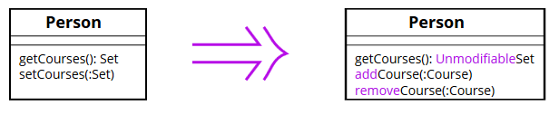
Encapsulate Collection
Notes:
A method returns a collection.
Make it return a read-only view and provide add/remove methods.

Slide 111
private ArrayList fieldDetails = new ArrayList();
private HashMap linkedFields = new HashMap();
private void setTransactionParams(Hashtable params) {
...
}
Notes:
Using collection framework classes as method parameters and variables

Slide 112
Use collection framework interfaces, use generics
private List<Field> fieldDetails = new ArrayList<>();
private Map<String,FieldProperties> linkedFields = new HashMap<>();
private void setTransactionParams(Map<String,Object> params) {
...
}

Slide 113
private void setParameters(HashMap<String,String> parameters) {
}
Notes:
Using classnames as method parameters

Slide 114
Use interfaces instead of classes
private void setParameters(Map<String,String> parameters) {
}

Slide 115
Outer outer = getObj();
if (outer != null && outer.nested != null && outer.nested.inner != null) {
System.out.println(outer.nested.inner.foo);
}

Slide 116
Removing null check
Optional.of(new Outer())
.map(Outer::getNested)
.map(Nested::getInner)
.map(Inner::getFoo)
.ifPresent(System.out::println);
int? length = customers?.Length; // null if customers is null
Customer first = customers?[0]; // null if customers is null
int? count = customers?[0]?.Orders?.Count(); // null if customers, the first customer, or Orders is null
Notes:
filter(Predicate predicate) This will return a value present only if it is present and that it matches a given predicate otherwise it will return an empty optional
ifPresent() This will returns true if a value is present in the optional.
ifPresent(Consumer consumer) This will invoke the specified consumer with the value, only if the value is present otherwise do nothing.
get() This will returns the value in the Optional if present, otherwise throws NoSuchElementException.
orElse(T other) This will return the value, if present, otherwise returns the value in other.
orElseGet(Supplier other) This will return the value if present, otherwise invoke other and return the result of that invocation.
orElseThrow(Supplier exceptionSupplier) This will return the value, if present otherwise throw an exception created by the provided supplier

Slide 117
basics

Slide 118
private List getTableColumns(Map tableFieldListMap) {
Set tables = tableFieldListMap.keySet();
Iterator iterator = tables.iterator();
while(iterator.hasNext()) {
String tableName = (String)iterator.next();
...
}
}
Notes:
Not using generics, Use of Iterator

Slide 119
Use generics, for..each loop
private List<String> getTableColumns(Map<String,Field> tableFieldListMap) {
for(String tableName : tableFieldListMap.keySet()) {
...
}
...
}

Slide 120
private static final String _ALPHABETS = "ALPHABETS";
private static final int _ALPHABETS_NO = 1;
private int getSwitchId(String value) {
if(value.equals(_ALPHABETS)) {
return _ALPHABETS_NO;
}
...
}
int switchId = getSwitchId(data);
switch(switchId) {
case _ALPHABETS_NO:
...
}
Notes:
Use of method to get switch case value

Slide 121
Use enum
private enum DataType { ALPHABETS,ALPHA_NUMERIC,NUMERIC,SWIFT,ALL,DATE,TIME
}
switch(DataType.valueOf(data)) {
case ALPHABETS:
...
}

Slide 122
public String getUpdateQuery() {
StringBuffer updateQuery = new StringBuffer();
...
return updateQuery.toString();
}
Notes:
Using StringBuffer as local variable
StringBuffer is synchronized i.e. thread safe. It means two threads can't call the methods of StringBuffer simultaneously.

Slide 123
Use StringBuilder for local variables
public String getUpdateQuery() {
StringBuilder updateQuery = new StringBuilder();
...
return updateQuery.toString();
}
Notes:
StringBuilder is non-synchronized i.e. not thread safe. It means two threads can call the methods of StringBuilder simultaneously.

Slide 124
strName = TextBox1.Text;
iAge = int.parse(TextBox2.Text);

Slide 125
Avoid Type Embedded in Name
name = TextBox1.Text;
age = int.pasre(TextBox2.Text);
Avoid placing types in method names; it's not only redundant, but it forces you to change the name if the type changes.

Slide 126
void Clean(int id)
{
Person object = myCollection.get(id);
boolean present = myCollection.remove(object);
}

Slide 127
Don't preserve return values you don't use
void Clean(int id)
{
Person object = myCollection.get(id);
myCollection.remove(object);
}

Slide 129
public class ServiceLocator {
Map<String,Object> cache;
public ServiceLocator() {
cache = Collections.synchronizedMap(
new HashMap<String, Object>());
}
}

Slide 130
ConcurrentHashMap has better performance than Collections.synchronizedMap
public class ServiceLocator {
ConcurrentMap<String,Object> cache;
public ServiceLocator() {
cache = new ConcurrentHashMap<String, Object>());
}
}

Slide 131
Map<String,String> parameters = new Hashtable<>();
Notes:
Use of Hashtable

Slide 132
ConcurrentHashMap has better performance than Hashtable
Map<String,String> parameters = new ConcurrentHashMap<>();
Notes:
ConcurrentHashMap is more scalable and performs better than Synchronized HashMap in the multi-threaded environment while in Single threaded environment both HashMap and ConcurrentHashMap gives comparable performance, where HashMap only slightly better.

Slide 133
if(condition)
do something
else
do something else

Slide 134
Use curly braces for if..else blocks
if(condition) {
//do something
}
else {
//do something else
}
Notes:
3. If..else blocks without braces

Slide 135
public String getColumns(List<Field> fields) {
String column = "";
StringBuilder columns = new StringBuilder();
for(Field field : fields) {
column = field.getColumn();
columns.append(column);
columns.append(",");
}
return columns.toString();
}

Slide 136
Declare variable only where required
public String getColumns(List<Field> fields) {
StringBuilder columns = new StringBuilder();
for(Field field : fields) {
String column = field.getColumn();
columns.append(column);
columns.append(",");
}
return columns.toString();
}
Notes:
Variables declared in procedural style – at the start of method

